Slide 1
Object Recognition and Classification of Video Data
BY: Olakunle Alabi

Slide 2
What is Object Recognition?
Object recognition is a computer technology that uses computer vision and image processing used to detect objects in images and videos.
The technology behind Object recognition is called the “Artificial Intelligence”

Slide 3
Architecture of Object Recogntion
Camera
Image Processing Unit
DATA COLLECTED via Computer Vision
Model
Using Machine and Deep Learning Algorithms
Results in form of Alert or Instructions

Slide 4
Object recognition industrial applications i. Security Surveillance Industry ii. Traffic Tracking systems iii. Advertising iv. Self-driving cars v. Activity Recognition vi. Face Recognition on phones

Slide 5
Convolutional Neural Network
These are special network that are specialized for image and video recognition, recommender systems and natural language processing (Handwriting recognition and speech recognition)
The main applications for CNN are as follows; i. Object detection and Recognition ii. Segmentation iii. Scene Classification

Slide 6
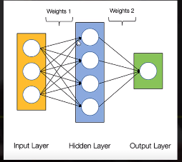
YoloV3 CNN PRETRAINED MODEL
This model “You only look once” (Yolo) is a deep learning algorithm which came out in May 2016 and it is so fast compared with the other deep learning object detection models. www.pjreddie.com/darknet/yolo

Slide 7
In this project I used ; i. Yolov3 pretrained model ii. OpenCV (Open Source Computer Vision library)
Yolo applies neural networks to the entire image to predict bounding boxes and their probabilities compared to other models which only applies their network to only high scoring regions on an image.
It also scans images once to make predictions, so it makes it about four times faster in practice than other models.

Slide 8
What can Yolo be applied to; i. Image file ii. Real-time video stream(Webcam) iii. Presaved Video file.
It can detect up to 80 objects, it has been pretrained to identify the 80 class labels of the coco dataset. i. Person iii. Car v…….. ii. Bicycle iv. Motorbike

Slide 9
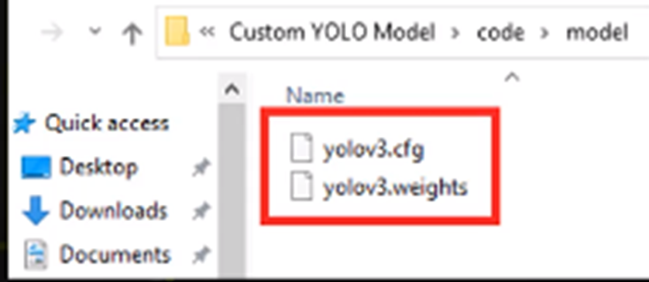
Transfer Learning i. Downloading Yolov3 weight file ii Downloading Yolov3 cfg file iii Downloading coco 80 dataset name file iv. Installing OpenCV

